Slide 1
Office 365 development

Slide 2
Setting up your on-premises environment for add-in development

Slide 3
Agenda
Creating a SharePoint Virtual Machine
Configuring Support for Add-ins
Configuring S2S authentication
Configuring OAuth2 for on-premises

Slide 4



Office Platform
WHAT CAN I BUILD?
ADD-INS AND WEB PARTS:
Make your solution a native part of the modern Office
WEB AND DEVICES APPS:
Build smarter apps by connecting to Office services
VOICE, VIDEO, CONNECTORS, AND BOTS
Create the next generation of productivity solutions

Slide 5
1
Creating a SharePoint Virtual Machine

Slide 6
Add-ins Dev Environment
1 Creating a SharePoint Virtual Machine
SharePoint 2013 with SP1 or SharePoint 2016
Visual Studio 2013 or 2015
Latest Visual Studio updates
Office Developer Tools for Visual Studio 2013 or 2015

Slide 7
Developer Site Collections
1 Creating a SharePoint Virtual Machine
Required for remote add-in development
Not required when developing locally
Use the Developer Site template to create a new site
Notes:
An SharePoint 2013 Developer Site makes it easier to get set up and start creating, testing, and deploying your apps for Office and SharePoint more quickly. Office 365 enterprise (E3 or E4) subscriptions include a site template you can use to create a Developer Site.

Slide 8
Demo Creating a SharePoint 2013 / 2016 Developer Site
1 Creating a SharePoint Virtual Machine
Notes:
Open SharePoint and add an Add-in from the Office Store (ex: Weather Widget, Tiny Links, etc)

Slide 9
Apps for Office Dev Environment
1 Creating a SharePoint Virtual Machine
Office 2013 with SP1 or Office 2016
Visual Studio 2013 or 2015
Visual Studio updates
Office Developer Tools for Visual Studio 2013 or 2015
Exchange 2013 or 2016 required for mail add-in development
At least Exchange 2013 SP1 required for compose mail apps

Slide 10
On-premises Setup Overview
1 Creating a SharePoint Virtual Machine
Steps
Create a new VM using a VM product such as Hyper-V
Install Windows Server, Active Directory and SQL Server
Install SharePoint Server 2013 with SP1
Install Visual Studio 2013 and update tools
Install Office 2013 with SP1
Configure support for SharePoint apps
Configure S2S authentication
Configure support for OAuth using Windows Azure ACS

Slide 11
Available Resources
1 Creating a SharePoint Virtual Machine
SharePoint 2013
Install and configure SharePoint 2013 - http://technet.microsoft.com/en-us/library/cc262957.aspx
Set up a general development environment for SharePoint 2013 - https://msdn.microsoft.com/en-us/library/office/ee554869.aspx
SharePoint 2016
Install and configure SharePoint 2016 - https://technet.microsoft.com/en-us/library/cc262957(v=office.16).aspx

Slide 12
Demo Reviewing the Installation Requirements for SharePoint 2013 / 2016
1 Creating a SharePoint Virtual Machine
Notes:
Open SharePoint and add an Add-in from the Office Store (ex: Weather Widget, Tiny Links, etc)

Slide 13
2
Configuring Support for add-ins

Slide 14
Service Application Support for Apps
Add-in support requires two service applications
App Management Service
Site Subscription Management Service
These services must be created in on-premises farms to support apps
SharePoint Farm
SharePoint Tenancy
App Management Service
App Instance Metadata
App Security Principals
App Permissions
App Licensing
Site Collection
Site
App
Site Subscription Settings Service
Tenancy Management
Site Collection Mapping
Notes:
The App Management Service is what manages the installation of apps. Any time an app is installed, SharePoint calls to the App Management Service which updates its database with metadata for the app to track various aspects of the app such as the app’s start page URL and security information for app authentication.
The Site Subscription Management Service is used by the SharePoint host environment to track tenancies. In the Office 365 environment, each customer is assigned its own tenancy. However, in on-premises farms the vast majority of SharePoint customers do not manage their site collections using tenancies. However, an on-premises farm still requires the Site Subscription Manage Service to be created. You can create an instance of the Site Subscription Manage Service in an on-premises farm using the following PowerShell script. Simply creating the service will create a single farm-wide default tenancy which meets the requirements for installing and running SharePoint apps. Note that the script shown here is also available in the Demo folder for this module under the name of CreateSubscriptionSettingsService.ps1 if you want to open it up and examine it.
# load in SharePoint snap-in
Add-PSSnapin Microsoft.SharePoint.PowerShell -WarningAction SilentlyContinue
# assign root domain name to configure URL used to access app webs
Set-SPAppDomain "apps.wingtip.com" –confirm:$false
$subscriptionSettingsService = Get-SPServiceInstance |
where {$_.TypeName -like "Microsoft SharePoint Foundation Subscription Settings Service"}
if($subscriptionSettingsService.Status -ne "Online") {
Write-Host "Starting Subscription Settings Service"
Start-SPServiceInstance $subscriptionSettingsService | Out-Null
}
# wait for subscription service to start
while ($service.Status -ne "Online") {
# delay 5 seconds then check to see if service has started sleep 5
$service = Get-SPServiceInstance |
where {$_.TypeName -like "Microsoft SharePoint Foundation Subscription Settings Service"}
}
$subscriptionSettingsServiceApplicationName = "Site Subscription Settings Service Application"
$subscriptionSettingsServiceApplication = Get-SPServiceApplication |
where {$_.Name -eq $subscriptionSettingsServiceApplicationName}
# create an instance Subscription Service Application and proxy if they do not exist
if($subscriptionSettingsServiceApplication -eq $null) {
Write-Host "Creating Subscription Settings Service Application..."
$pool = Get-SPServiceApplicationPool "SharePoint Web Services Default"
$subscriptionSettingsServiceDB= "Sharepoint_SiteSubscriptionSettingsServiceDB"
$subscriptionSettingsServiceApplication = New-SPSubscriptionSettingsServiceApplication `
-ApplicationPool $pool `
-Name $subscriptionSettingsServiceApplicationName `
-DatabaseName $subscriptionSettingsServiceDB
Write-Host "Creating Subscription Settings Service Application Proxy..."
$subscriptionSettingsServicApplicationProxy = New-SPSubscriptionSettingsServiceApplicationProxy `
-ServiceApplication $subscriptionSettingsServiceApplication
}
# assign name to default tenant to configure URL used to access web apps
Set-SPAppSiteSubscriptionName -Name "WingtipTenant" -Confirm:$false

Slide 15
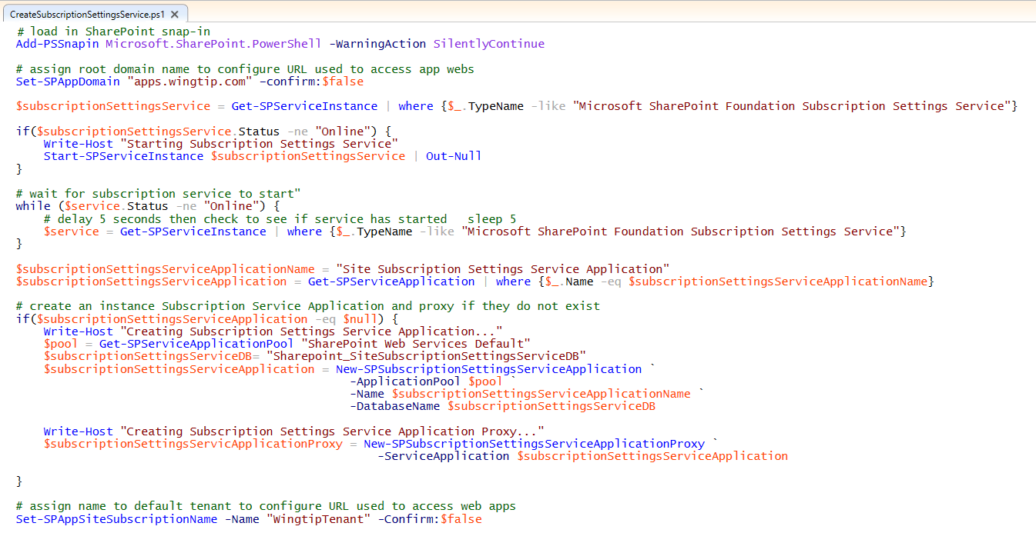
Configuring Support for Apps

Slide 16
On-premises – SP hosted add-in domain Explains the structure with multiple farms domain requirements
If SP hosted apps are planned to be used in the on-premises farm, specific wild card add-in domain has to be registered for each of the SharePoint farms
Add-in domain for SP hosted apps is recommend be dedicated new domain for providing domain level isolation
on-premises farm 1
on-premises farm 2
SharePoint farm
SharePoint farm
https://portal1
https://portal2
https://collab1
https://collab2
https://*.farm1.contosoapps.com
https://*.farm2.contosoapps.com

Slide 17
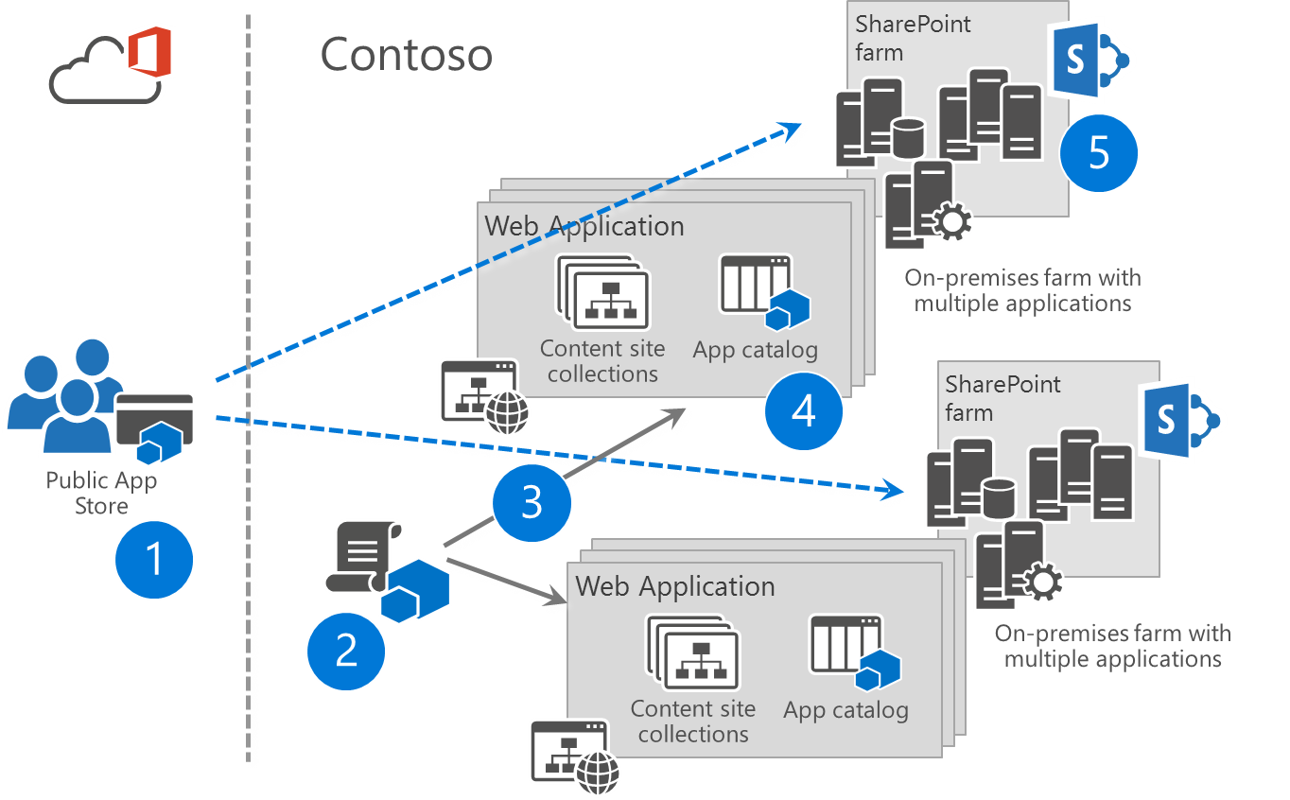
Corporate app store in enterprise level Explains the structure for app catalogs in web application level
Each application has it’s own corporate app catalog in on-premises
This also applies to Office365 Dedicated
In Converged platform there is only one catalog for all of the site collections hosted in that environment
Corporate wide deployment of add-in requires add-in to be copied cross multiple farms and applications. This can be automated with scripting since there’s no native capability in the SharePoint for this.
Note. Descriptions in slide notes
Notes:
Public store can be enabled or disabled in farm level. When enabled, administrators can configure apps to be directly available for installation or that end users have to request them from the the admins. Public store requires internet connectivity from the SharePoint farm
Apps can be deployed cross multiple applications using scripting.
Apps can be deployed to be available in each catalog in web application and in farm level using PowerContoso and client side object model (CSOM)
There is one app catalog for each web application in the farm. This gives us opportunity to provider only web application level publishing of the apps or app to be just available for specific organization
Scripting of the deployment cross multiple farms can be also done. There’s no native capability to move apps between web applications or multiple SharePoint farm.

Slide 18
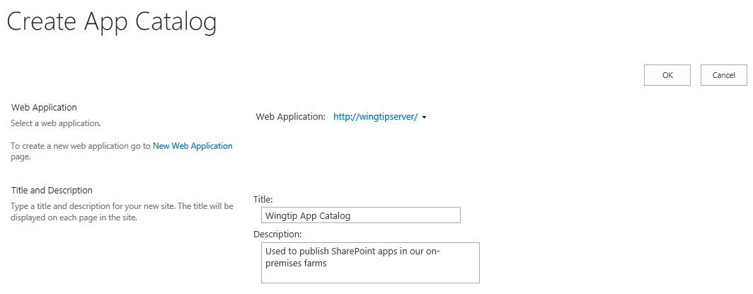
Creating the App Catalog Site Collection
You must create the App Catalog site collection
You can create it using a PowerShell script
You can create it using Central Administration
App Catalog site associated with one web application

Slide 19
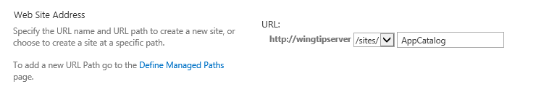
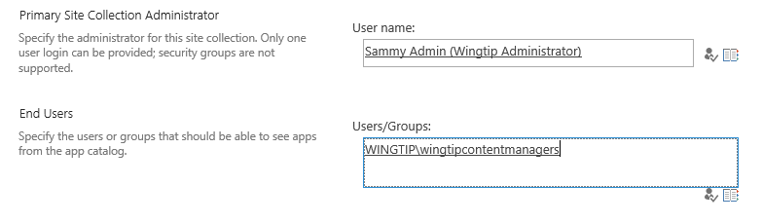
App Catalog URL and Permissions
App catalog site created at a specific URL
Creating App Catalog site with PowerShell is more flexible you can create site as top-level domain using host-named site collections (HNSCs)
Setting App Catalog permissions
Site collection administrator becomes App Catalog administrator
End user permissions allows user to discover and install apps

Slide 20
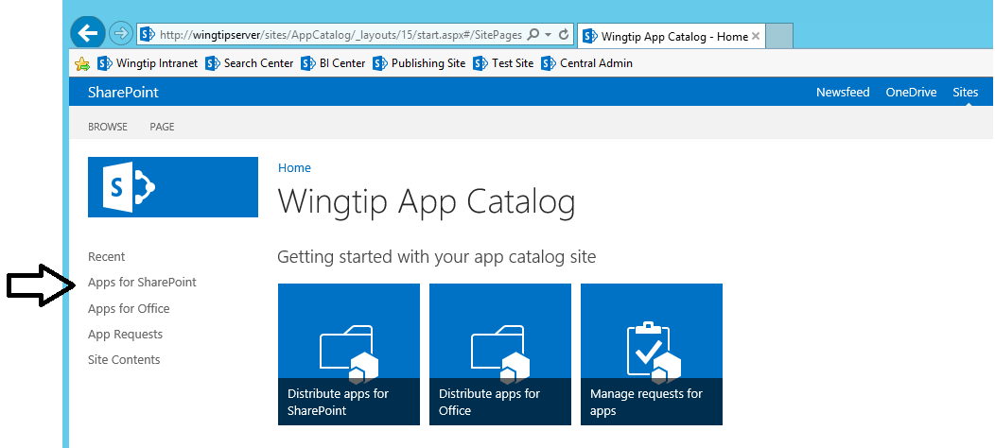
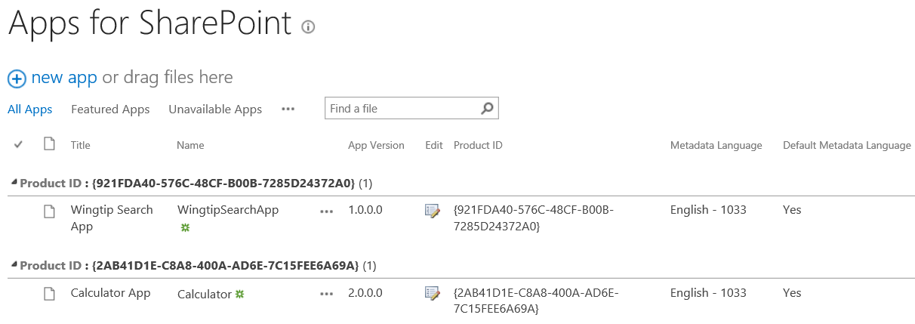
Apps for SharePoint Document Library
Apps for SharePoint is special document library
It's the place where you publish SharePoint apps
You upload add-in package and enter the related metadata

Slide 21
Creating the App Catalog Site Collection
2 SharePoint add-ins
Demo

Slide 22
3
Configuring S2S authentication

Slide 23
What is a Server-to-server (S2S) Trust
Trusted connection between add-in and SharePoint
Eliminates need for ACS when running apps in on-premises farm
Trust between servers configured using SSL certificates
Add-in code requires access to private key of SSL certificate
Requires creating Security Token Service on SharePoint server(s)
Private Network Environment
SharePoint Web Server
S2S STS
1
User
3
4
2
Client App
SSL Cert
Public/Private key pair (.pfx)
Notes:
SharePoint 2013 makes it possible for Web servers in a SharePoint farm to a client app requests using a server-to-server (S2S) trust. This type of configuration can be used when deploying developer-hosted apps in a private network when it is beneficial to avoid any dependencies on ACS or any other servers running across the Internet. That means that all the servers involved can run behind a single firewall and on the same local area network.
A S2S trust represents a trusted connection between a client app running on a local app server and the Web servers in the SharePoint farm. Configuring the trust requires an SSL certificate which is based on the URL with the DNS name (e.g https://appserver.wingtip.com) where the client app is located. The client app contains code which has access to the private key associated with the SSL certificate and it uses this private key to sign security tokens. On the SharePoint Web Server, you must create a security token service which can use the public key to authenticate and decrypt these security tokens generated by the client app.

Slide 24
High trust (S2S) with provider hosted Logical flow
Registration of certificate
Server Admin
Configuration of certificate
1
2
SharePoint Farm
Remote connectivity
Provider hosted add-ins
Approve and publish apps
7
3
Add-in Admin
Verification of certificate
6
spapp_appnane.contoso.com
4
5
End Users

Slide 25
Configuring a Server-to-Server Trust
Steps to configure an S2S trust
Create an x509 certificate
Make certificate’s public key accessible to SharePoint
Use PowerShell to create a trusted security token issuer based on public key
Develop provider-hosted add-in which has access to private key file
Create S2S access tokens with the help of TokenHelper class
Pass access token with calling into SharePoint using CSOM or REST API
Two ways to make a certificate available
Pass file path of certificate to SharePoint
Expose certificate from add-in as metadata endpoint

Slide 26
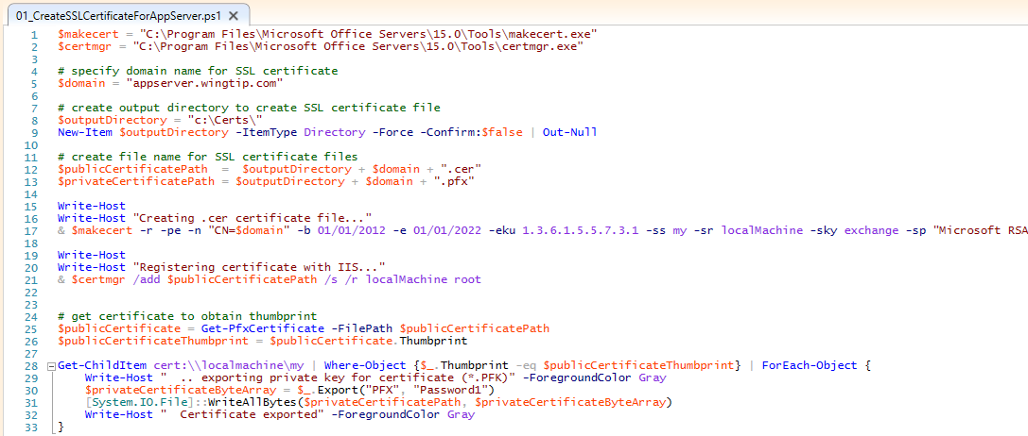
Creating Certificates
Notes:
This is an example of a PowerShell script that creates a self-signed SSL certificate for an app running at the DNS name of http://appserver.wingtip.com. The self-signed certificate is made by calling the makecert.exe utility. Note that the script creates the self-signed certificate with a private key. This certificate is then installed into the certificate store on the local machine using the certmgr.exe utility. The code at the bottom of the script shows how to enumerate through the SSL certificates stored on the local machine and to find those that have private keys. The call to Export is what produces a private key file that is signed with the password of Password1.

Slide 27
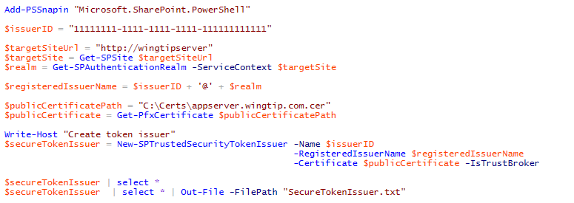
Creating the Secure Token Issuer
Steps to creating security token issuer in SharePoint farm
Get the authentication realm (aka tenancy)
Create realm-qualified add-in identifier
Create certificate object using .pfx file containing password-protected private key
Call New-SPTrustedSecurityTokenIssuer
Notes:
To configure an S2S high trust connection in an on-premise SharePoint farm, you must use Windows PowerShell and SharePoint 2013 cmdlet named New-SPTrustedSecurityTokenService. When you call the New-SPTrustedSecurityTokenService cmdlet ou mus pass it a string-based name and the URL to the metadata discovery endpoint for the app. SharePoint then uses the metadata in the JSON token returned from the metadata discovery endpoint to properly create the new STS configured with the correct public key.
After creating the S2S trust between the client app and the SHarePoint Web servers, it is then required to register one on more app principals using the Register-SPAppPrincipal cmdlet. Note that app principals are scoped to a tenancy. If all the sites in the on-premise local farm are running within the default tenancy, you can create a single farm-wide app principal.
Once you have create the app principal, you can then assign permissions to it using the Set-SPAppPrincipalPermission cmdlet.

Slide 28
App Principals
External authentication requires app principals
App principal is a tenancy-scoped account for app identity
App principal identified using a GUID
App principals must be created in SharePoint host
App principal properties
Client ID: GUID-based identifier for app principal
Client Secret: (not used in S2S)
App Host Domain: Base URL of remote web
Redirect URL: URL to a page used to configure on-the-fly security

Slide 29
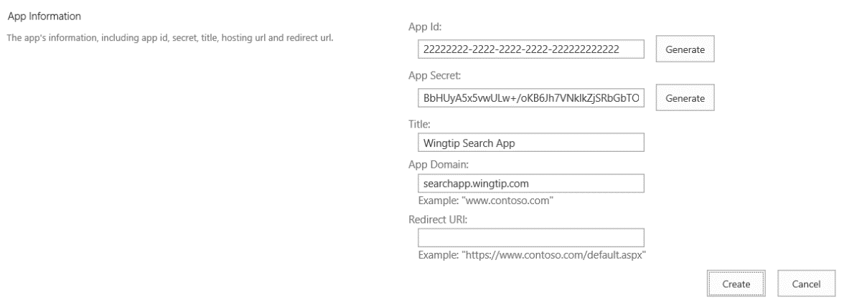
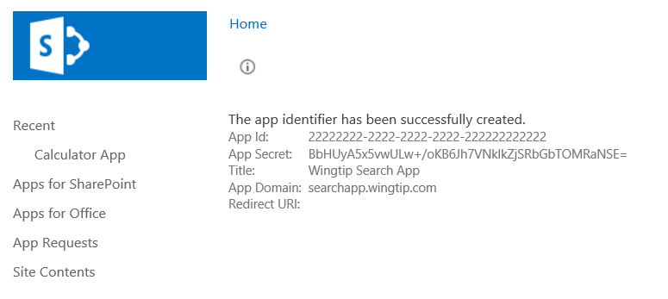
Registering an App Security Principal
Done automatically by Visual Studio during development
When you press {F5}, VS automatically registers app principal
Visual Studio also updates web.config file
Can also be done using AppRegNew.aspx page

Slide 30
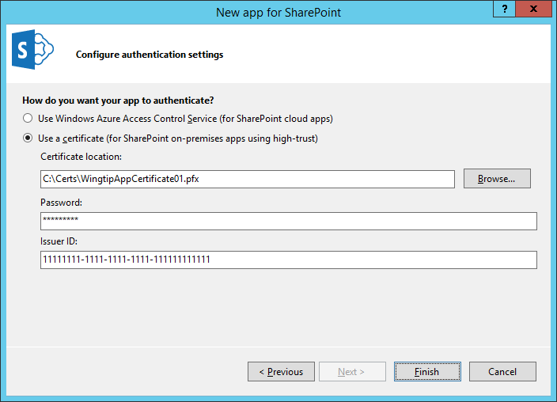
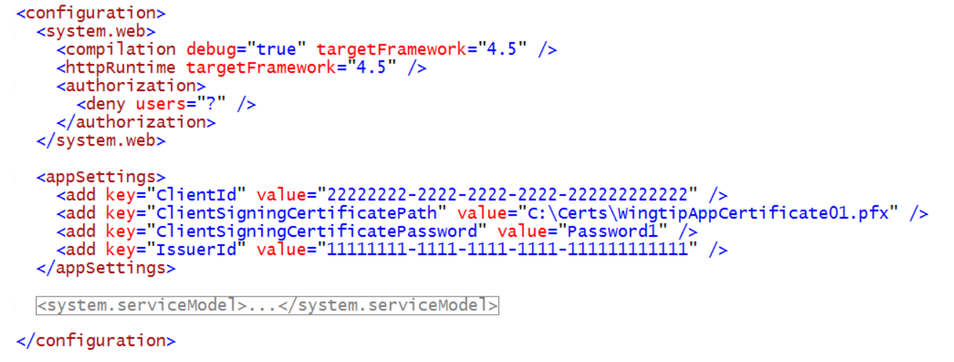
Configuring the S2S Certification in VS
Visual Studio provides two add-in authentication options
Use Windows Azure Access Control Service (this means OAuth)
Use a certificate (this means S2S)

Slide 31
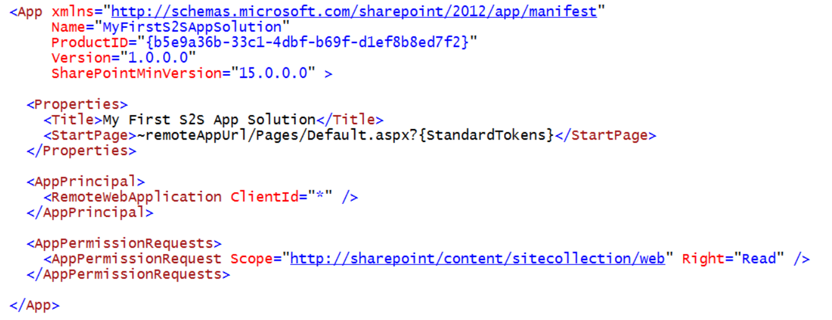
Add-in Manifest during Development

Slide 32
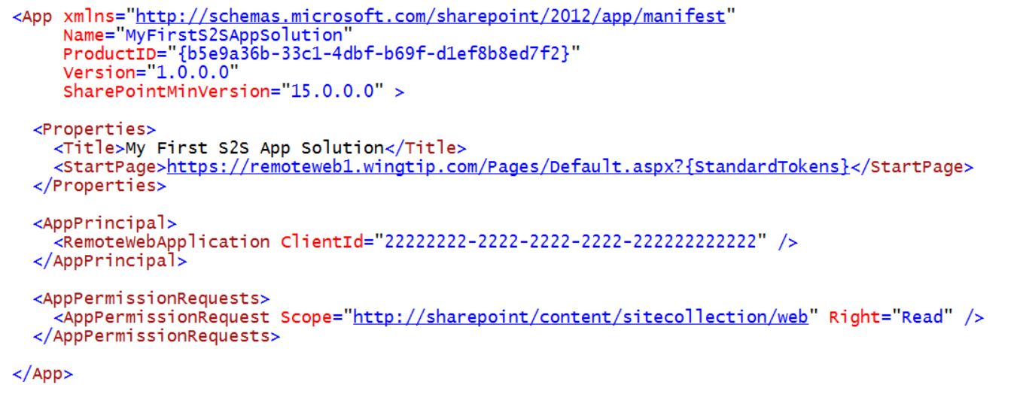
Add-in Manifest in Real-world Deployment

Slide 33
4
Configuring OAuth2 for on-premises

Slide 34
Azure Active Directory
Identity and Access Management for the cloud
Can create new directories or manage existing ones in Azure subscription
Used by O365 for authentication
Used by Azure for user authentication and application authorization
Notes:
Azure Active Directory is a comprehensive identity and access management cloud solution. It combines core directory services, advanced identity governance, security, and application access management. Azure AD also offers developers an identity management platform to deliver access control to their applications, based on centralized policy and rules.

Slide 35
Windows Azure Environment
4 Configuring oAuth2 for on-premises
Azure Active Directory (AAD)
Azure Access Control Services (ACS)
Azure Web Sites

Slide 36
Azure Access Control Services
4 Configuring oAuth2 for on-premises
Identity and Access Management for the cloud
More generic than AAD
Supports additional providers Google, Yahoo, Facebook
Can create new namespaces in Azure subscription
Used by O365 for application authorization
Notes:
Windows Azure Access Control Service (ACS) is a Windows cloud-based service that provides an easy way of authenticating and authorizing users to gain access to web applications and services while allowing the features of authentication and authorization to be factored out of the application code. This facilitates application development while at the same time providing users the benefit of being able to log into multiple applications with a reduced number of authentications, and in some cases only one authentication.

Slide 37
Low trust flow with provider hosted add-ins Logical flow
Registration of add-in
Add-in Admin
2
End Users
ACS
Approve and publish
4
5
3
7
Verification of registration
Provider hosted add-ins
SharePoint Farm
6
1
Remote connectivity
Associate server to Office 365 tenant
Server & Tenant Admin
spapp_appnane.contoso.com

Slide 38
Configuring Support for Oauth in an On-premises Farm
4 Configuring oAuth2 for on-premises
Demo

Slide 39
Summary
Creating a SharePoint Virtual Machine
Configuring Support for Add-ins
Configuring S2S authentication
Configuring OAuth2 for on-premises

Slide 40
Further reading…
SharePoint Code Samples
SharePoint Training videos & hands on labs
SharePoint documentation
SharePoint patterns and practices solution guidance

Slide 41
Engage

